Slide 1



DASH_PO_2
View in Power BI
Last data refresh:
7/26/2022 10:55:26 AM UTC
Downloaded at:
7/26/2022 10:56:19 AM UTC

Slide 2
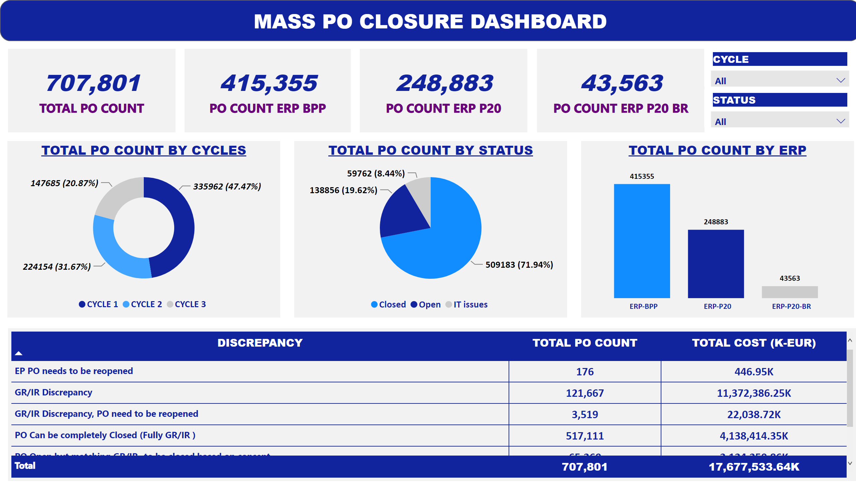
CYCLEWISE DASHBOARD
Notes:
card
No alt text provided
card
No alt text provided
actionButton
No alt text provided
TOTAL PO COUNT BY CYCLES
No alt text provided
TOTAL PO COUNT BY STATUS
No alt text provided
TOTAL PO COUNT BY ERP
No alt text provided
pivotTable
No alt text provided
card
No alt text provided
card
No alt text provided
slicer
No alt text provided
slicer
No alt text provided

Slide 3
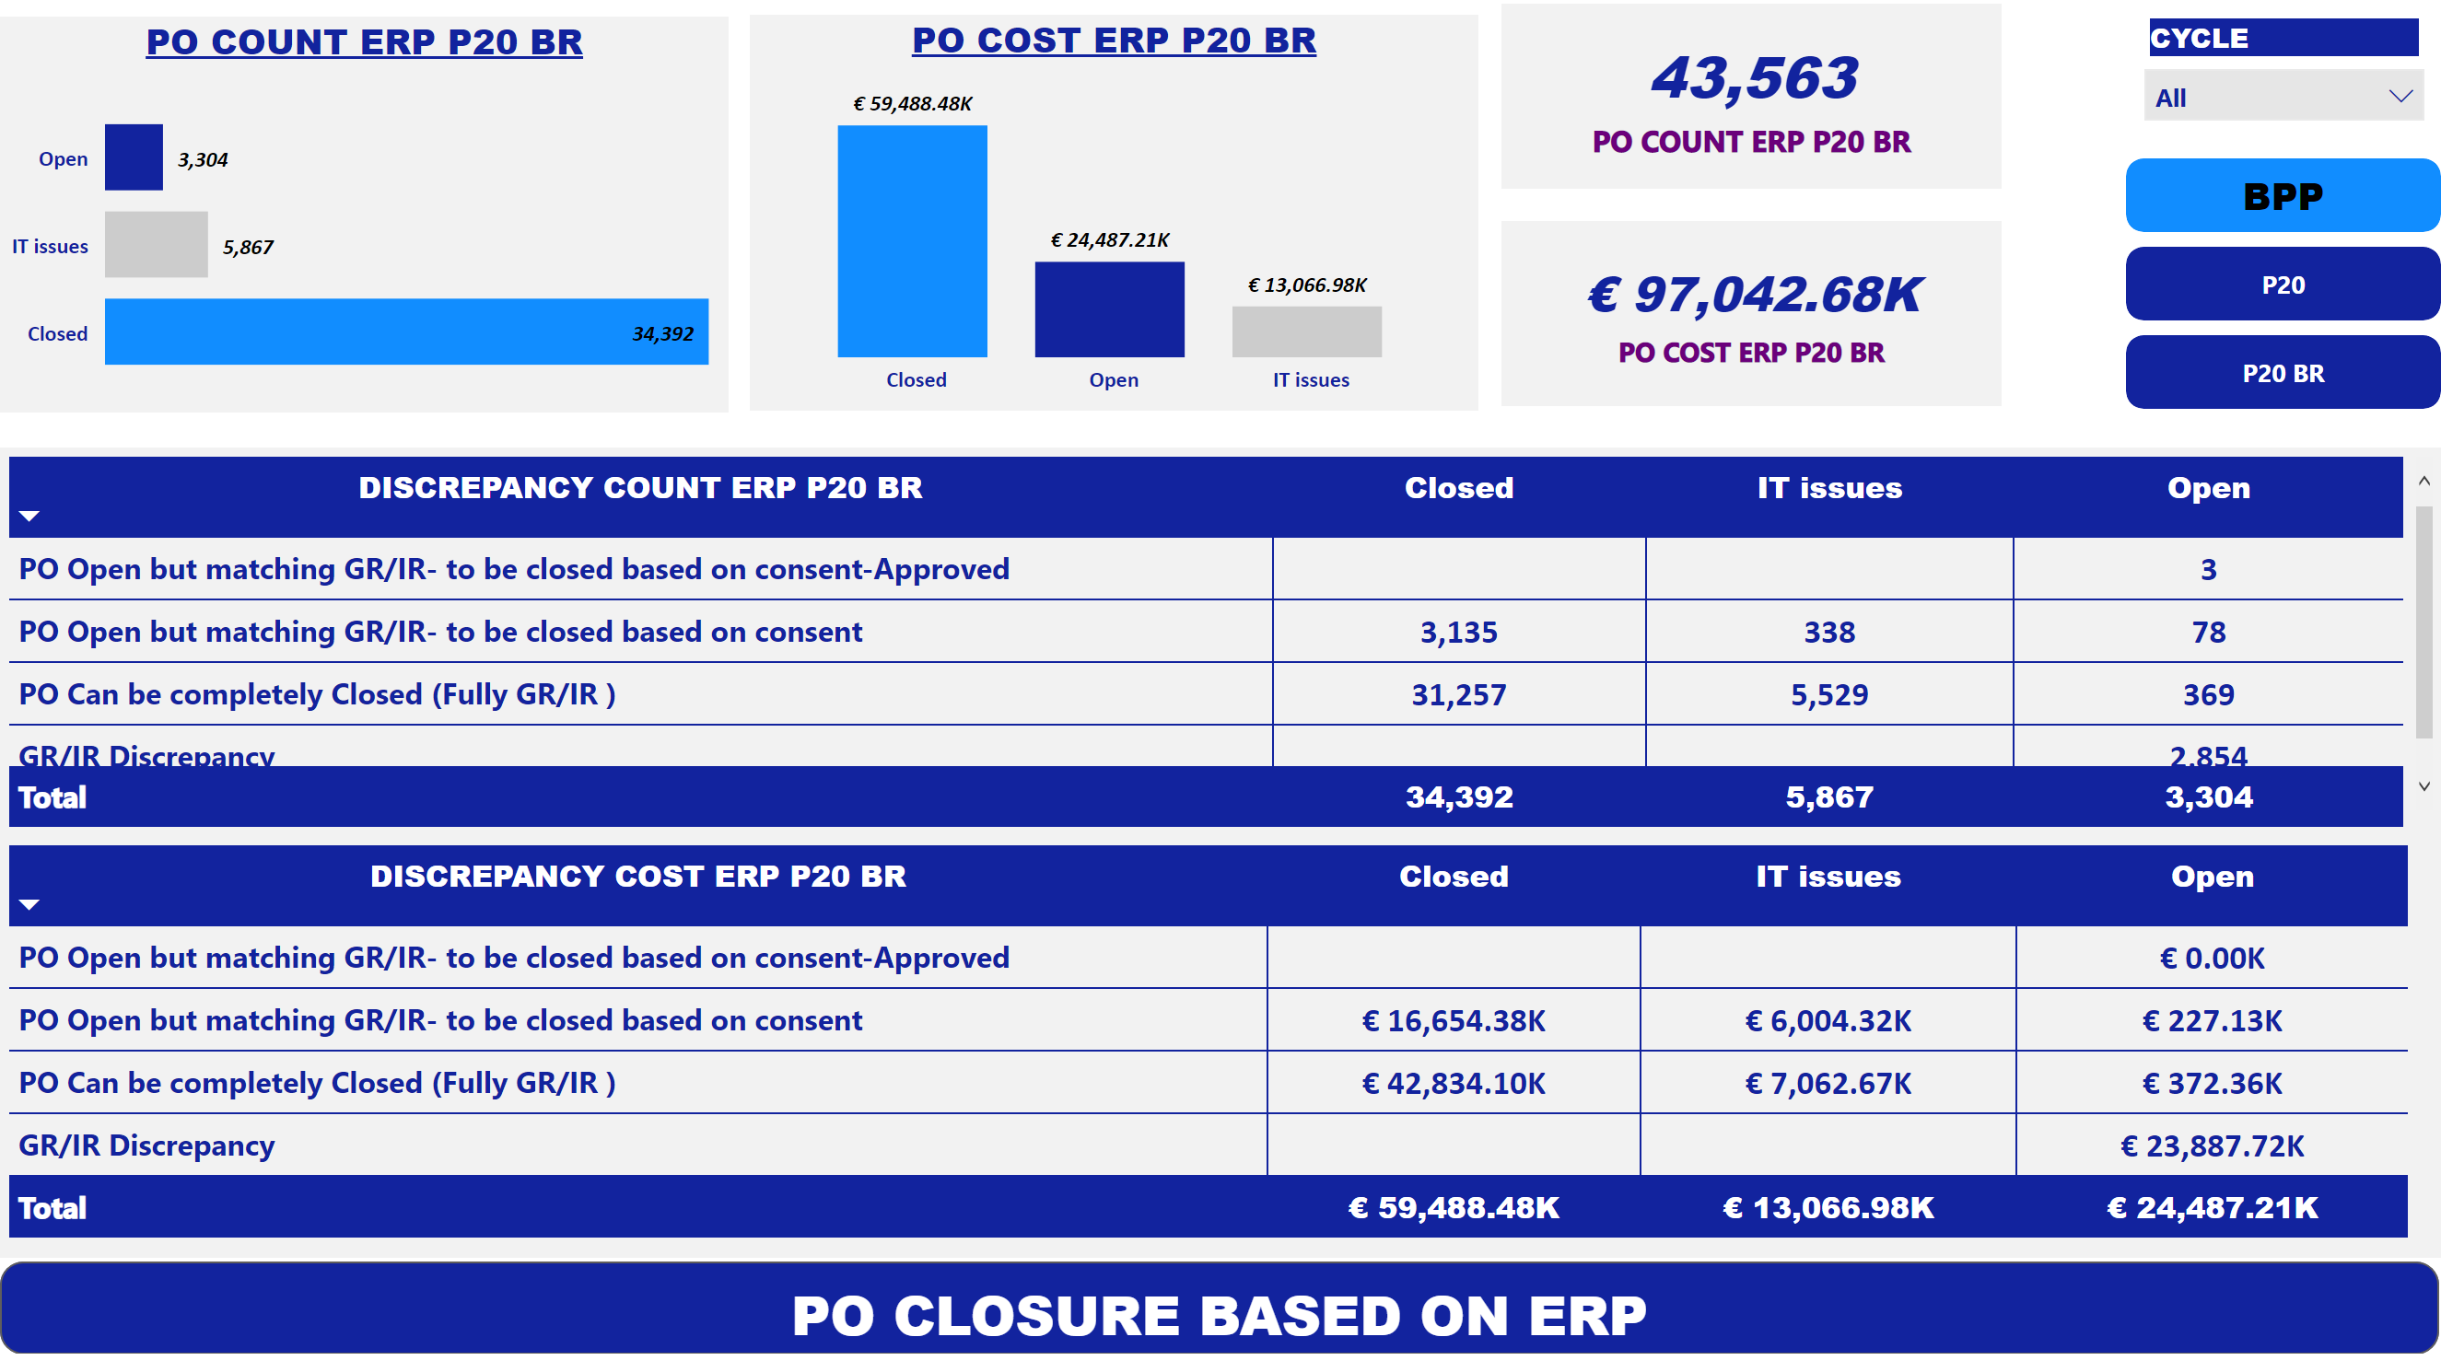
ERPWISE DASHBOARD
Notes:
pivotTable
No alt text provided
pivotTable
No alt text provided
barChart
No alt text provided
clusteredColumnChart
No alt text provided
card
No alt text provided
card
No alt text provided
slicer
No alt text provided
pivotTable
No alt text provided
pivotTable
No alt text provided
barChart
No alt text provided
clusteredColumnChart
No alt text provided
card
No alt text provided
card
No alt text provided
pivotTable
No alt text provided
pivotTable
No alt text provided
card
No alt text provided
card
No alt text provided
PO COST ERP P20 BR
No alt text provided
PO COUNT ERP P20 BR
No alt text provided
bookmarkNavigator
No alt text provided
actionButton
No alt text provided

